Slide 1
Unit 6-4
Trapezoids and Kites
PLANE Geometry

Slide 2




Trapezoid:
A Quadrilateral with Exactly One Pair of Parallel Sides
BASE
$$A$$
$$B$$
LEG
LEG
$$D$$
$$C$$
BASE

Slide 3
Isosceles Trapezoid:
A Trapezoid in which the Legs are Congruent.
BASE
$$A$$
$$B$$
LEG
LEG
$$D$$
$$C$$
BASE

Slide 4





If a Trapezoid is Isosceles, then Each Pair of Base Angles is Congruent.
$$A$$
$$B$$
$$D$$
$$C$$

Slide 5








Example 1:
Given an Isosceles Trapezoid, find the Missing Measures.
$$A$$
$$B$$
$$1$$
$$2$$
$$3$$
$$65°$$
$$D$$
$$C$$

Slide 6


Example 2:
Given an Isosceles Trapezoid, Find x.
$$A$$
$$B$$
$$4x+15$$
$$3x+25$$
$$D$$
$$C$$

Slide 7





If a Trapezoid is Isosceles, then its Diagonals are Congruent.
$$A$$
$$B$$
$$D$$
$$C$$
$$\overline{AC}≅\overline{BD}$$

Slide 8




Example 3:
Find x in the Isosceles Trapezoid.
MP = 3x + 4
LN = 2x + 5
$$M$$
$$L$$
$$N$$
$$P$$

Slide 9
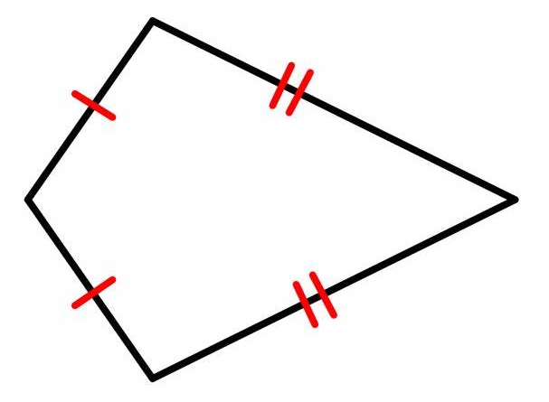




Kite:
A Quadrilateral with Exactly Two Pairs of Consecutive Sides
  Opposite Sides are Not Congruent or Parallel
$$P$$
$$S$$
$$Q$$
$$R$$

Slide 10
Kite:
If a Quadrilateral is a Kite, then its Diagonals are Perpendicular.
$$P$$
$$S$$
$$Q$$
$$R$$

Slide 11
Kite:
If a Quadrilateral is a Kite, then Exactly One Pair of Opposite Angles is Congruent.
$$P$$
$$S$$
$$Q$$
$$R$$

Slide 12
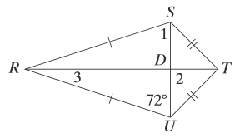
Example 4:
Find the Measures of the Missing Angles.

Slide 13








Example 5:
Find the Measures of the Missing Angles.
$$P$$
$$1$$
$$S$$
$$130°$$
$$Q$$
$$70°$$
$$2$$
$$R$$

Slide 14



Example 6:
Find the Measures of the Missing Angles.
$$P$$
$$55°$$
$$S$$
$$1$$
$$Q$$
8$5°$
$$2$$
$$R$$

Slide 15








Example 7:
Find the value of x and y.
$$P$$
$$2x+12$$
$$3x−4$$
$$S$$
$$Q$$
$$11$$
$$y+12$$
$$R$$

